Slide 1


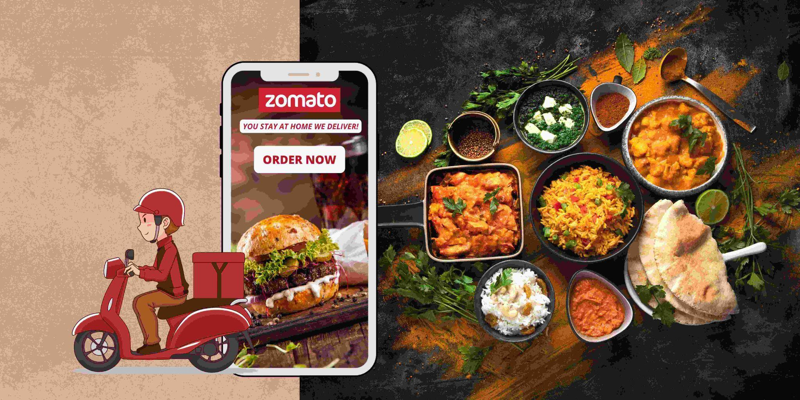
Zomato Restaurants Analysis
Sumitra Bishnoi

Slide 2
A Bit About Zomato
Zomato is your ultimate food companion, connecting you to the best dining experiences around. Whether you're craving a quick bite, a fine dining experience, or the perfect late-night snack, Zomato helps you discover, order, and enjoy with ease. With a vast network of restaurants, real-time reviews, and seamless delivery.
Every meal becomes an experience worth savoring!

Slide 3
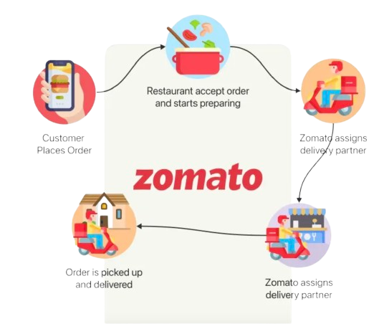
How Zomato Works

Slide 4
Expanding Zomato’s Reach: Data-Driven Strategy
Key Focus Areas:
📌 Market Analysis 📌 Concept Development
📌 Marketing & Growth 📌 Customer Engagement
📌 Optimal Location Selection
Challenge:
You are hired as a consultant data analyst by Zomato where the team is looking for expansion and opening restaurants. Your task is to come up with strategies/suggestions about opening newer restaurants.

Slide 5
Data Overview
Restaurant ID: Unique identifier for each restaurant.
Restaurant Name: The name of the restaurant.
CountryCode: Country code of the location where the restaurant is situated.
City: The city where the restaurant is located.
Address: The specific address of the restaurant.
Locality: The locality or neighborhood where the restaurant is situated.
Locality Verbose: Detailed information about the locality.
Longitude: The geographical longitude coordinate of the restaurant.
Latitude: The geographical latitude coordinate of the restaurant.
Cuisines: The type of cuisine offered by the restaurant.
Currency: The currency used for transactions in the restaurant.
Has_Table_booking: Indicates whether the restaurant has a table booking option (Yes/No).
Has_Online_delivery: Indicates whether the restaurant offers online delivery (Yes/No).
Is_delivering_now: Indicates whether the restaurant is currently delivering (Yes/No).
Switch_to_order_menu: Indicates whether users can switch to the order menu (Yes/No).
Price_range: A numeric value indicating the price range category of the restaurant.
Votes: The number of votes or ratings/(feedback) received by the restaurant.
Average_Cost_for_two: The average cost for two people dining at the restaurant.
Rating: The overall rating of the restaurant is based on user reviews.
Datekey_opening: The date when the restaurant was opened.

Slide 6
Approach
Optimized Data Strategy for Expansion
Refined Data Processing
Data Standardization – Cleaning city names to ensuring format consistency.
Dataset Enrichment – Adding country descriptions for deeper insights.
Analytical Approach
Excel-Driven Insights – Utilizing pivot tables, IF functions, and statistical tools.
Pattern Recognition – Identifying key trends for strategic decision-making.
Essential Toolkit
Data Analysis – Extracting meaningful insights from raw data.
Excel Mastery – Leveraging LOOKUP functions, logical operators, and pivots.
Clarity & Precision – Translating technical insights into actionable strategies.

Slide 7
Methodology: Data Optimization & Analysis
Data Processing & Enrichment
Geolocation Cleanup – Removed and filled zero values for latitude & longitude.
Country Mapping – Used VLOOKUP to retrieve country names from codes.
Data Transformation
Extracting Year – Applied LEFT() function to derive years and CHOOSE() function to derive quarters from full dates.
Custom Pricing – Created tailored price columns for better segmentation.
Currency Conversion – Standardized values into INR for consistency.
Handling Missing Data
Cuisine Imputation – Filled missing values with popular choices in respective cities.
Price Adjustments – Used average values based on given price ranges.
Analysis & Visualization
Pivot Tables – Generated descriptive summaries for deeper insights.
Dashboards & Charts – Designed visual representations for strategic decision-making.

Slide 8
Data Analysis & Insights
Understanding the Dataset
Familiarization & Key Insights – Explored data structure and identified crucial elements.
Data Cleaning – Removed duplicates and inconsistent values for accuracy.
Analytical Approach
Pivot Table Insights – Generated key insights through multiple pivot tables:
Restaurant Distribution – Number of restaurants by country.
Service Availability – Online delivery & table booking preferences.
Customer Engagement – Average votes, ratings, and review patterns.
Formula Application – Utilized IF, AND, COUNTIF functions for refined analysis.
Conditional Formatting – Highlighted key countries for better visualization.
Market Expansion Research
Identified strategic locations for expansion in: 1. Canada 2. Qatar 3. Singapore 4. Sri Lanka 5. Philippines

Slide 9
KPI’s
Total Restaurants
9551
Total Countries
15
Total Cities
141
Average Rating
9551
Total Sales
8.12M
Total Cuisines
1826

Slide 10
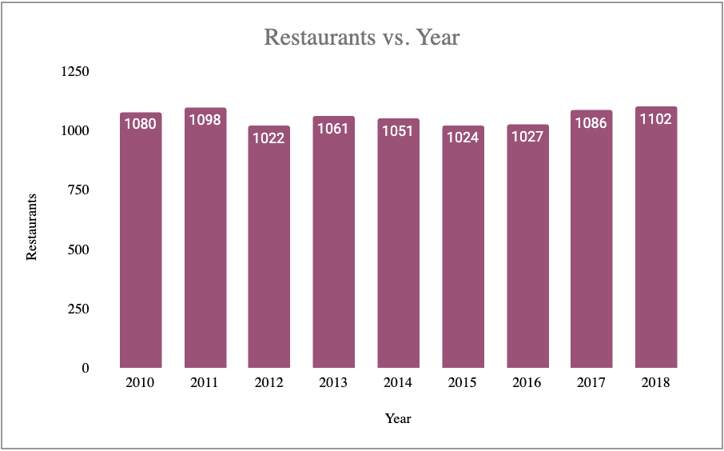
RESTAURANT OPENED IN YEAR
As per the findings we can see that Highest number of restaurants opened in 2018 1102 and Lowest number of restaurants opened in 2012 1022

Slide 11
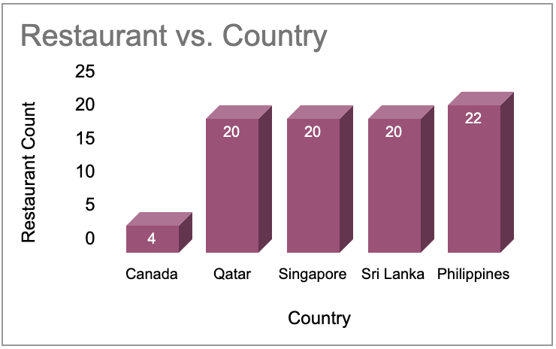
COUNTRY SELECTION
APPROACH : Identification of countries with less number of restaurants, and poor average ratings.
Visualisation tool : Stacked Column chart through pivot table construction.
Insights: Across 10 cities of these 5 countries,
We have only 124 restaurants.
Recommended countries : CANADA , QATAR, SINGAPORE, SRI LANKA, PHILIPPINES

Slide 12
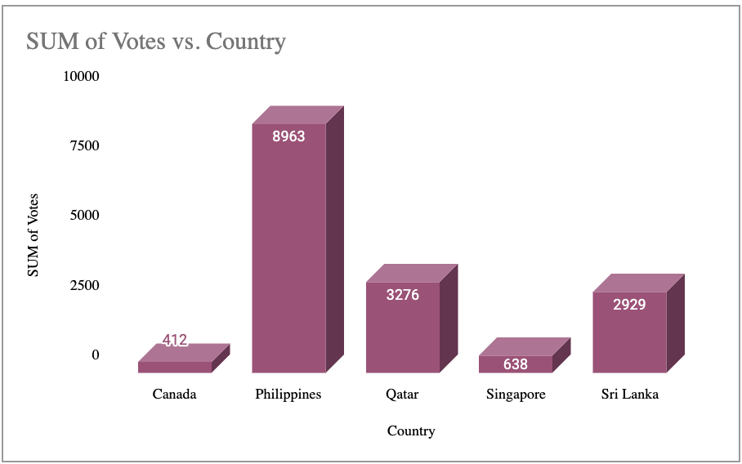
COUNTRY VS SUM OF VOTES
Sum of votes is highest for Philippines 8963 while is lowest
for canada as 412.
We can interpret for the need of better choices in Canada, Singapore after looking the Low count.

Slide 13
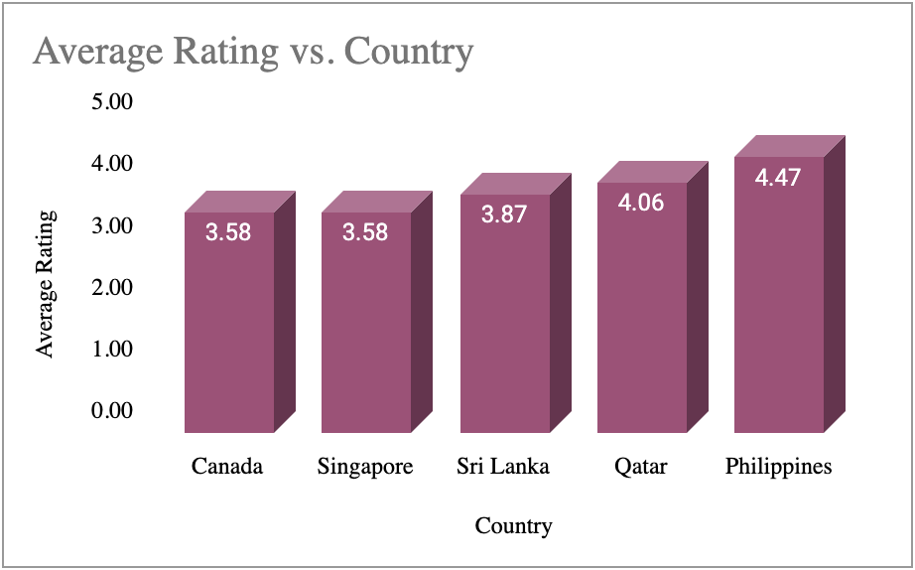
COUNTRY VS AVERAGE RATINGS
Our main motive was to choose the countries where present average ratings are below or near by 4.
The reason was simple, we needed countries where the present restaurants are not offering enough customer satisfaction.
We can see Philippines has highest rating as 4.47, while Canada got 3.58 only among the countries we choose.

Slide 14
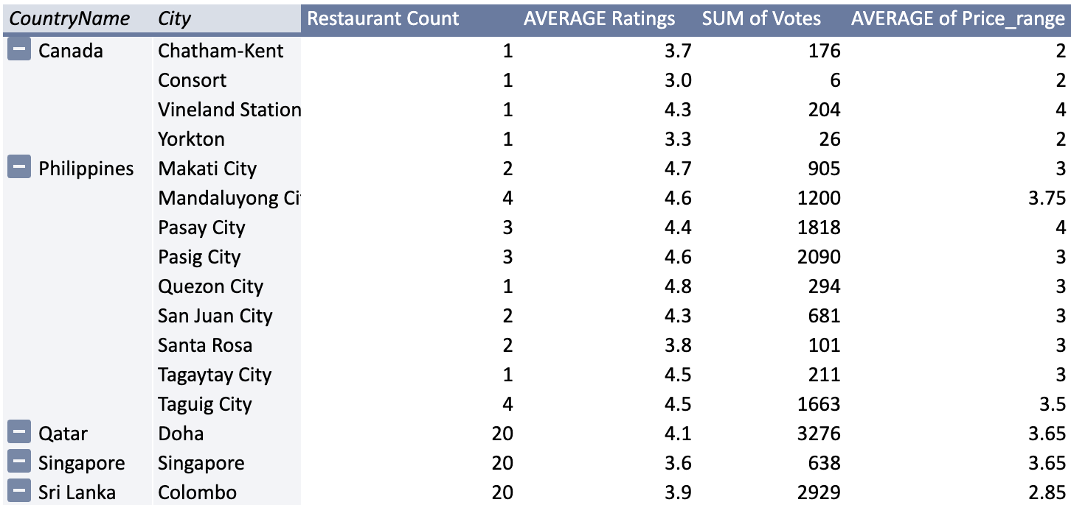
CITY SELECTION
INSIGHTS: Upon Checking The Relations Between Average Rating, Cost And Sum Of Votes, We Arrived Upon Following Options, That Lacked Good Choices From Present Restaurants.

Slide 15
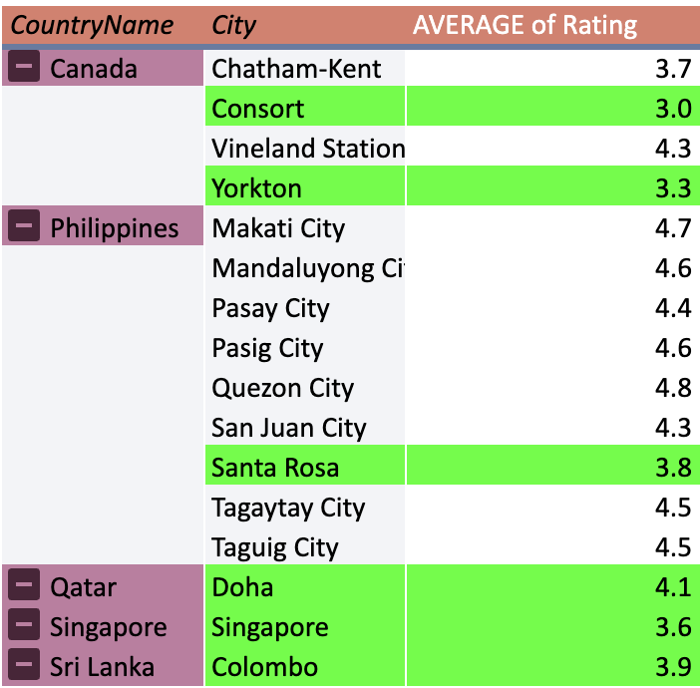
CITY SELECTION
CITY RECOMMENDATION
We Applied Conditional Formatting For The Cities That Can Be Ideal Choice For Market Expansion
We Tried Choosing Cities Where Presently Average Ratings Are Not Good.
Other Factors Like Sum Of Votes, Average Expenditure Were Also Checked.

Slide 16
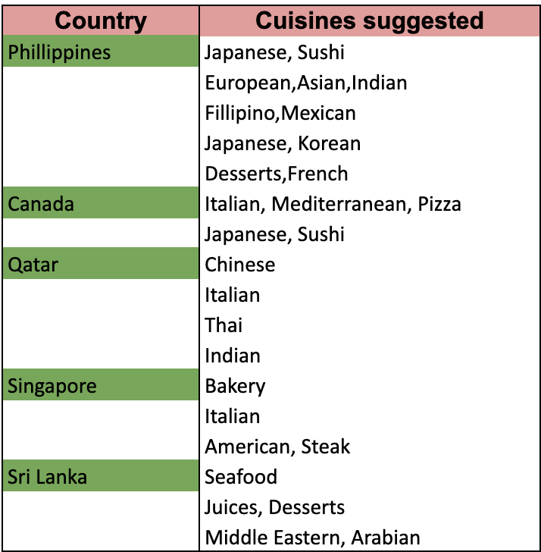
CUISINE SELECTION
INSIGHTS:
After looking into the bulky pivot, it became necessary to filter and shortlist
some some popular cuisines, and that too according to country and so we prepared a table for the same.
RECOMMENDATIONS:
Following are the cuisines on bases of average ratings nearly or above 4, that means they are popular and are segregated according to Recommended countries.

Slide 17
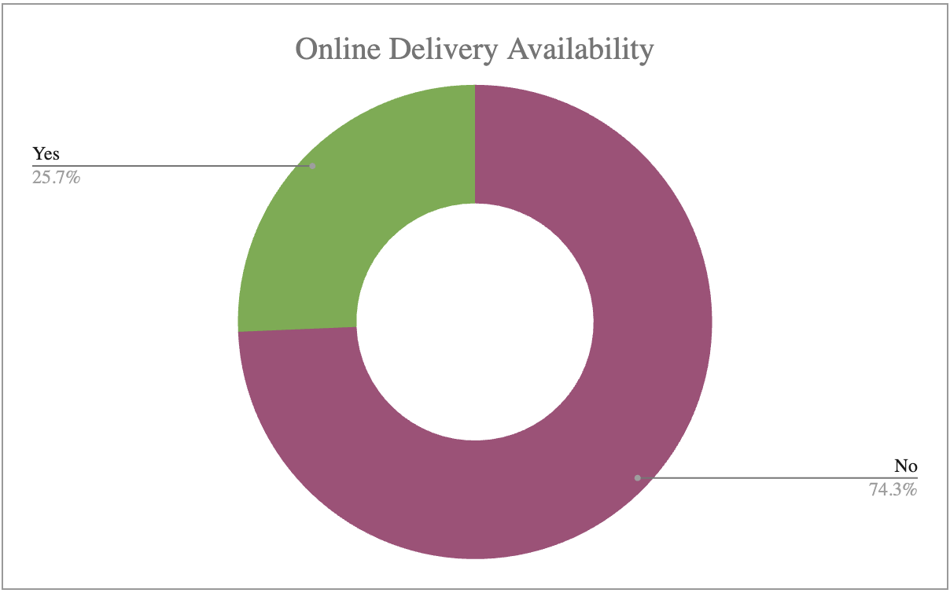
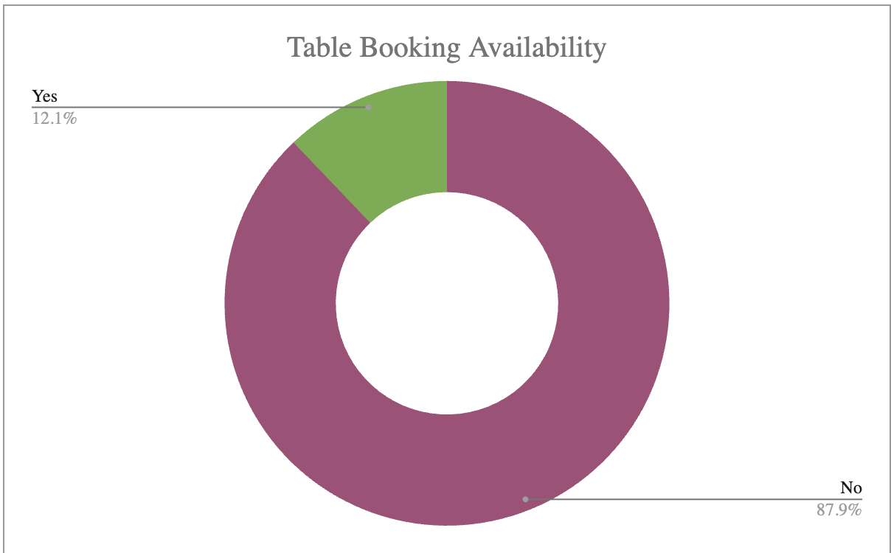
ONLINE DELIVERY /TABLE BOOKING
RECOMMENDATIONS
The data reveals that over 75% of the market remains untapped for online delivery and table booking, highlighting a significant growth opportunity in this sector. Additionally, restaurants offering these services tend to have higher average ratings, making online delivery and table booking a strategic and customer-preferred choice for expansion.

Slide 18
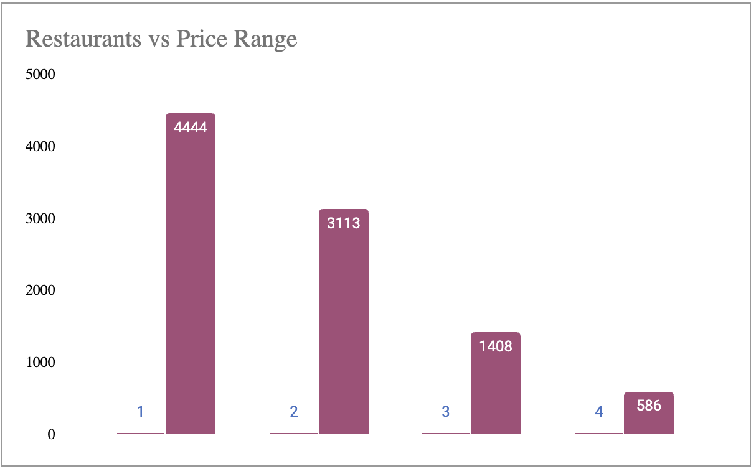
EXPENDITURE ANALYSIS
The dataset includes over 9K+ restaurants spanning different price segments.
Price Range 4 (highest) has the lowest number of restaurants with only 586.
Price Range 1 (lowest) has the highest count, with 4444 restaurants.
Price Range 2 includes 3113 restaurants.
Price Range 3 consists of 1408 restaurants.

Slide 19
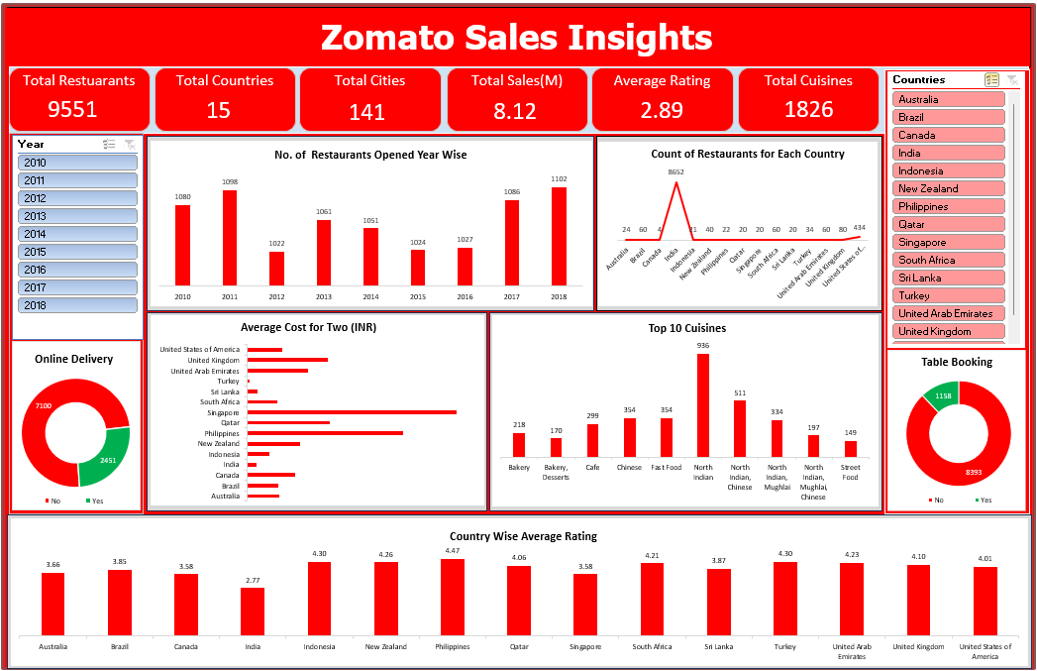
DASHBOARD

Slide 20
RECOMMENDATIONS
Higher prices correlate with better ratings and a smaller selection of cuisines, making niche markets a strategic choice.
Mid-range (Price Range 3-4) dominates the market, making it ideal for budget-friendly options and breakfast offerings.
Countries with fewer restaurants present opportunities, provided the right cuisine is offered at an optimal price.
Target regions with low competition and poor ratings but a high volume of votes.
Enhance quality in low-rated restaurants to justify premium pricing and increase customer spending.
Capitalize on the untapped potential of online delivery and table booking services.

Slide 21
CONCLUSION
Analyzed data from 9,000+ restaurants to identify key expansion opportunities.
Focused on selecting the best locations, cuisines, and price brackets for Zomato’s growth.
Applied data science and analytical techniques to refine 10-15 optimal choices.
Incorporated ratings, local preferences, and votes to ensure strategic decision-making.
Mapped price specialization to consumer preferences for maximum market impact.

Slide 22
THANK
YOU

